Slide 1
The 2024 Election-What Happened and What Now
By Michael DeLong
President
Montgomery County Young Democrats

Slide 2
2024 Election Results in Maryland
Reason to be moderately pleased
Angela Alsobrooks won the Senate election and will be Maryland’s next Democratic Senator—first Black woman Senator from our state
April Delaney narrowly won the election for Maryland’s 6th Congressional District
Question 1 passed, enshrining abortion rights in Maryland’s Constitution
Question A passed, limiting the Montgomery County Executive to two terms

Slide 3
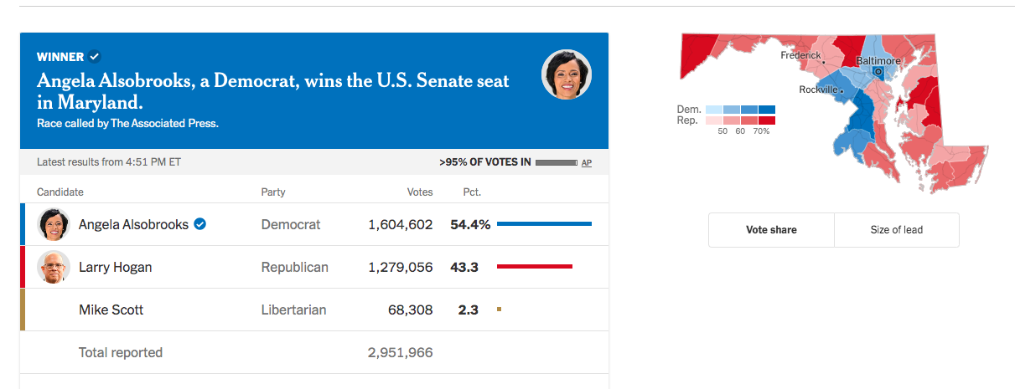

Slide 4
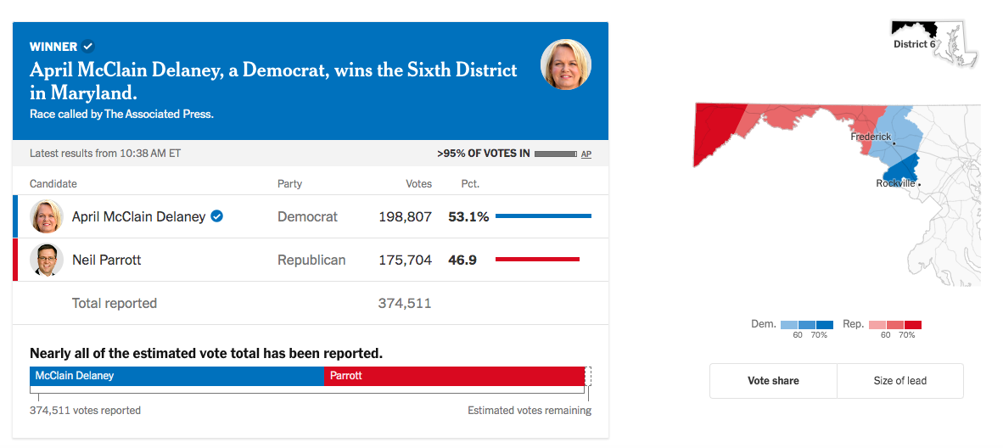

Slide 5
National Election Results—Not Good!
Donald Trump beat Kamala Harris by a small but decisive margin
Republicans picked up several Senate seats & will have 53 seats in the Senate, while Democrats will have 47
Lost several good Senators—Sherrod Brown from Ohio, Bob Casey in Pennsylvania, Jon Tester in Montana
Republicans gained one seat in the House and will narrowly control it by the slimmest of margins: 219 to 213
Second Trump administration, even after everything he has done

Slide 6
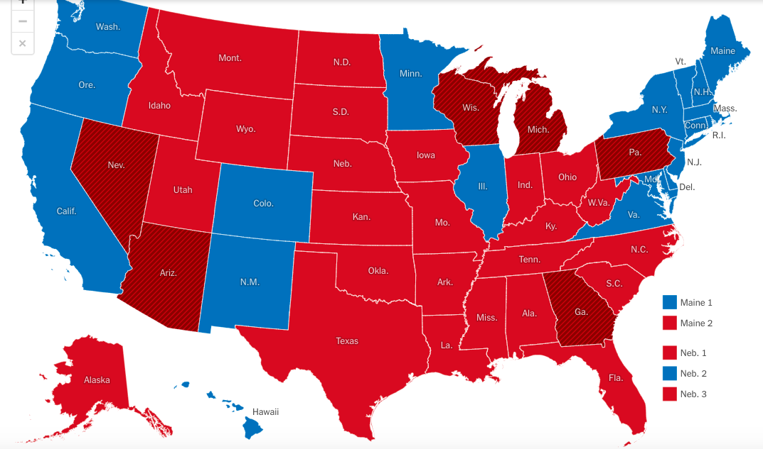

Slide 7
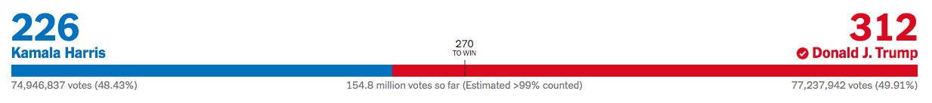

Slide 8
What the Hell Happened? Several Possibilities
Polls were close and reasonably accurate
But understated Trump’s support—he and only he is able to get a bunch of voters to the polls. Improved on his margins in most places
Turnout was extremely high—not a case of Democrats staying home, but Trump voters turning out and some Democrats voting Trump
Harris had to assemble a campaign from scratch, define herself, almost did it
Swings toward Trump were smaller in the battleground states, likely because of her campaign

Slide 9
Frustration With the Economy
Some voters were frustrated with the economy because of inflation and high prices
Most of this was not Biden’s fault—his plans boosted the economy and prevented mass unemployment
Voters looking for someone to blame & Kamala Harris perceived as a quasi-incumbent
Inflation is down, but voter perceptions of the economy lagged behind
“Remember when a hamburger cost $10?”

Slide 10
Immigration—Perception vs. Reality
Trump hates immigrants and vowed to crack down on them, which has a powerful constituency
Southern border perceived as open and insecure, even though that wasn’t the case
Biden more friendly to immigration
Can’t underrate xenophobia—even a bunch of immigrants voted for Trump, thinking he is only against the “bad” immigrants
Sexism may have played a factor as well

Slide 11
Polarization by Income and Education
Educated voters with a college degree moved toward the Democrats
Voters without a college degree moved toward the Republicans
More voters without a college degree—significantly more
Income is trickier, but wealthier people seem to have voted more Democratic
Many working class and poor people voted Democratic
But a significant number did not—chose Trump!
Part of a longer political trend

Slide 12
Two Rainbow Coalitions
Most dismaying part—Trump made big gains with certain groups of voters
More Latino voters chose him—not a majority but a strong minority
More Asian American voters chose him
Small but significant number of Black men voted for him as well
He won more votes in cities, which is why he is likely to win the popular vote
Gender divide, with women more likely to vote Harris
Two rainbow coalitions—Democrats and Republicans

Slide 13
Misinformation and Political Ignorance
Hard to measure
Harris won voters who read the news—subscribe to newspapers or political sites, follow politics closely, are knowledgeable
Trump won voters who pay little attention to politics, are relatively low information, vote based on vibes
Lots of misinformation swirling out there—Harris wants to take your guns, defund the police, make you pay for transgender surgeries

Slide 14
Culture Wars and Issues
Abortion rights have a lot of advocates but also a lot of opponents
Trump claimed he didn’t support a national abortion ban
Democrats thrown on the defensive about immigration and concerns about people coming across the border
Crime was a significant issue in certain areas, and that is one issue where Republicans are perceived to have the advantage
Transgender rights—Trump ran ads highlighting this and claiming that Harris wanted to make the public pay for surgeries

Slide 15
Likely First Steps of the Trump Administration
Next four years will be very bad. Chaos will help us in certain ways, but expect a lot of damage
  Depriving people of health care—likely attempts to repeal the Affordable Care Act
  Opposing Medicaid expansion to provide health care to the poor and disadvantaged
  Further restrictions on abortion and contraception—anti-choice groups planning to file more lawsuits and oppose efforts by women to travel to get abortions
  No effective consumer protection, since government positions will be filled by plutocrats and big business

Slide 16
Likely First Steps of the Trump Administration (Continued)
Trump will promote tax cuts for the rich
Will likely try to implement tariffs, which will drive up prices and increase inflation. Could send economy into a tailspin
Stephen Miller will attempt mass deportations of undocumented immigrants, and to reduce legal immigration as much as possible
Abuse of power—Trump may try to go after his critics and harass them, or worse
Courts may push back, but Congress won’t. And the Supreme Court will be useless

